Slide 1
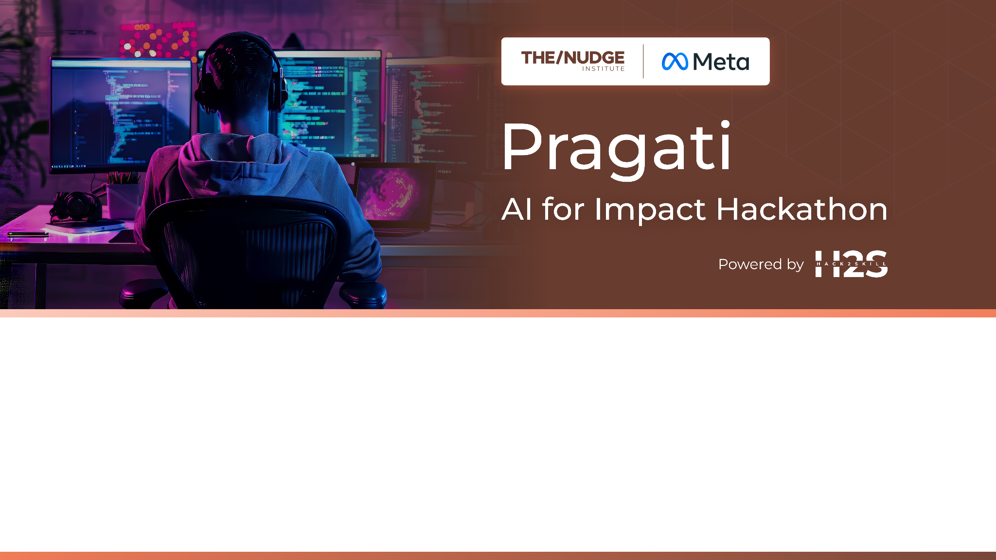
Team Name : Team V
Team Leader Name : Pranjal Mishra
Which domain does your idea address? (Agriculture / Healthcare / Skilling / Education): Healthcare

Slide 2

What is the problem you are solving? (50 words max)
we’re building an AI-powered healthcare assistant for rural India that works via voice calls on feature phones and through a lightweight app on smartphones. It helps ASHA workers detect high-risk pregnancies, prevent anemia, access offline support, and spread health scheme awareness in local languages with risk free Loan Assement.

Slide 3
Describe your solution. How different is it from any of the other existing ideas? How will it be able to solve the problem? USP of the proposed solution? What is the intended impact of your solution (max 350 words).
Aarogya Saathi is an AI-powered healthcare assistant built for rural India, aiming to bridge the healthcare gap through accessible technology. The solution works via voice calls on basic feature phones and a lightweight Android app, both supporting multiple Indian languages. It empowers ASHA workers and rural citizens to access reliable health support without requiring internet connectivity or smartphones , btw in India people prefer there cultural food over balanced diet fixing there thought process with better knowledge in there own local language.
Main Features:
It uses lightweight on-device AI models and IVR (Interactive Voice Response) to deliver voice-guided pregnancy risk assessments, even in low-network areas.
The system can understand local-language medical queries and provide instant health guidance using NLP tailored for Indian dialects.
Aarogya Saathi is designed to be offline-first, with features like smart caching of medical data and health schemes, and automatic syncing once the internet is available.
What Makes It Unique:
Unlike most digital health solutions that rely on smartphones and stable internet, this solution works on any phone.
The approach is voice-first, language-first, and focuses on inclusive design for communities with low digital literacy and to teach them also about balanced Diet.
Our Goal:
The intended impact is to reduce maternal and infant mortality, provide ASHA workers with intelligent tools, and bring equitable healthcare access to India’s most underserved regions using scalable AI-driven tech and Educate people about balanced diet .

Slide 4
Who is the primary user of your solution, and explain how your solution will leverage open-source AI to address the aspects mentioned in the Key Design Guidelines (max 200 words).
The primary users of Aarogya Saathi are people in rural and underserved areas with limited access to healthcare and digital infrastructure. While designed to support ASHA workers, with important features is meant for anyone with a basic phone, especially pregnant women and families seeking trusted medical guidance.
Aarogya Saathi leverages open-source AI models like Whisper for speech recognition and Indicbert for understanding regional languages. These models are optimized to run offline and on low-end devices, ensuring accessibility even without internet. The system uses IVR and lightweight on-device AI to offer voice-based health support in multiple Indian languages , even it can be used on shared device with security features , we will be making it keeping every aspect of society in mind.
This approach supports the Key Design Guidelines by being:
Inclusive (supports all phones and local languages)
Low-resource friendly (works offline, minimal infrastructure needs)
Ethical (respects user privacy, open-source based)
Scalable and affordable (built using flexible, community-driven tools)
By combining open-source AI with a voice-first, offline-first design, Aarogya Saathi delivers critical health support to those who need it most.

Slide 5
How is this solution scalable? (100 words max)
🔹 Built with modular, open-source AI tools – easily customizable for different regions and languages
🔹 Offline-first architecture – works without internet, ideal for rural deployment
🔹 Compatible with feature phones and low-end smartphones – no need for expensive devices
🔹 Lightweight on-device models with cloud sync – ensures smooth performance and scalability
🔹 Can integrate with existing government schemes and NGO networks for wide rollout
🔹 Low cost, high reach – scalable across India’s diverse geographies with minimal infrastructure

Slide 6
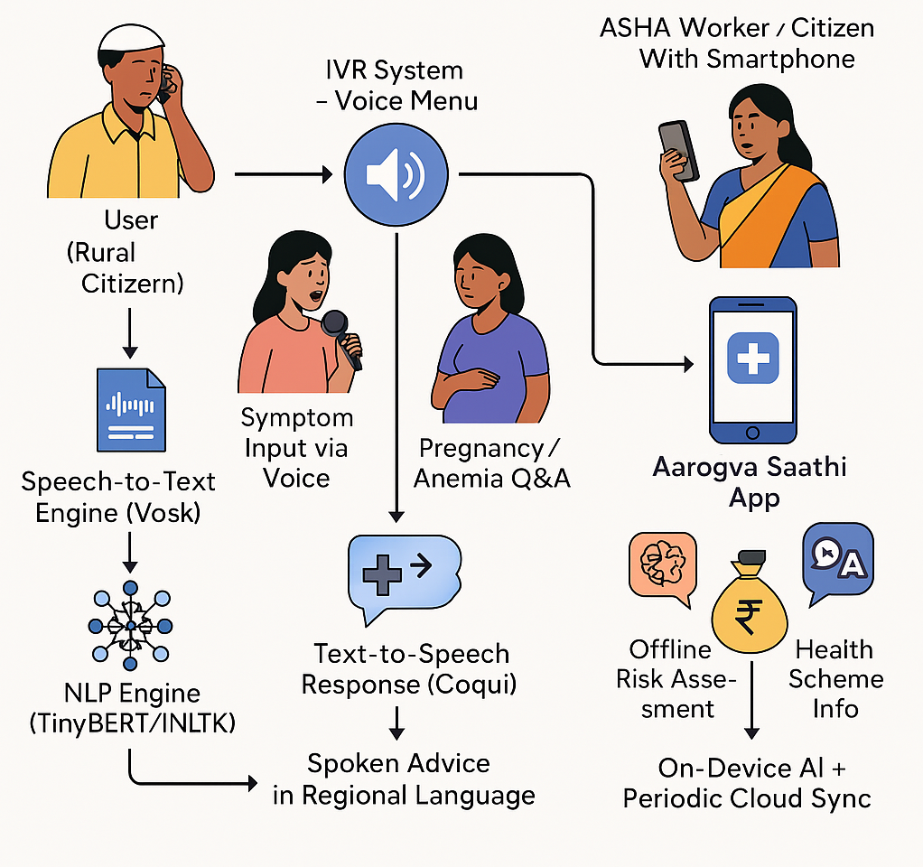
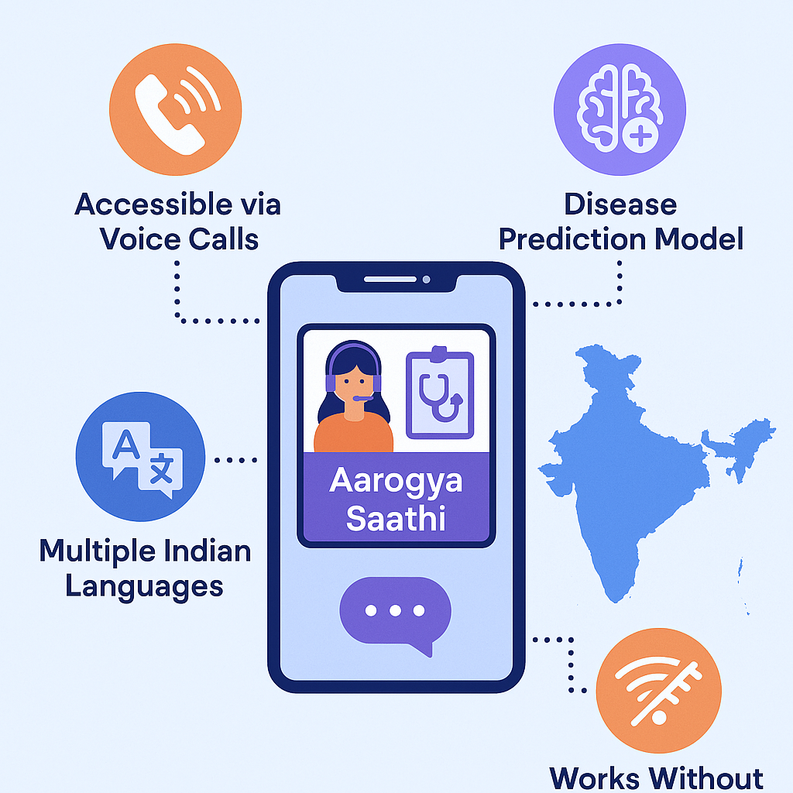

List of features offered by the solution
It is always better to add a few visual representations (drawings/sketches/illustrations etc.) to your presentation, it adds to the power through which it reaches the audience.

Slide 7
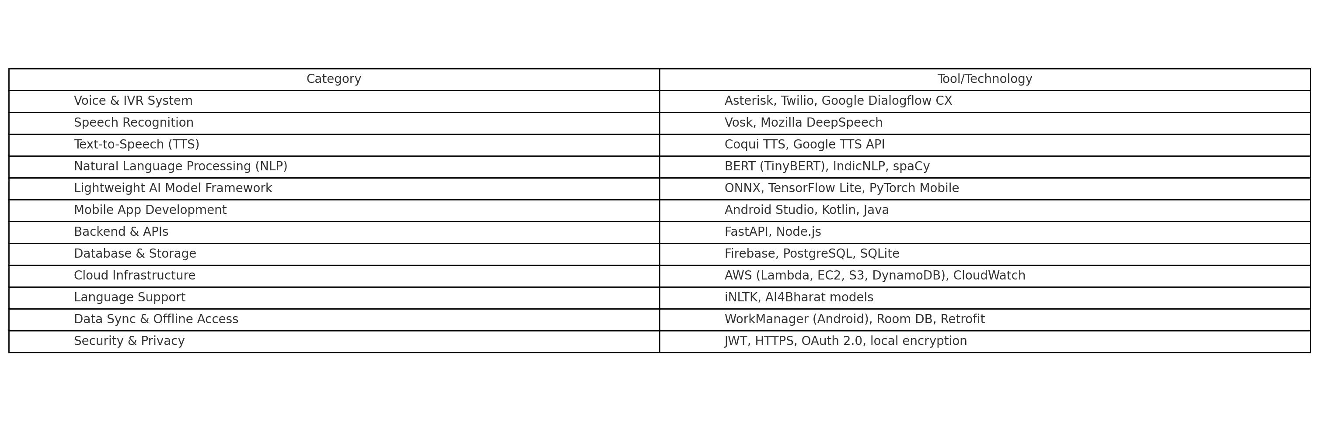
What open-source AI tools and technologies will you use to design the solution? (Please list all.)
We use a range of open-source technologies including Asterisk, Vosk, Mozilla DeepSpeech, Coqui TTS, TinyBERT, IndicNLP, spaCy, ONNX, TensorFlow Lite, PyTorch Mobile, Android Studio, Kotlin, Java, FastAPI, Node.js, PostgreSQL, SQLite, Room DB, Retrofit, WorkManager, iNLTK, AI4Bharat models, JWT, OAuth 2.0, and local encryption methods. These tools ensure our solution remains cost-effective, adaptable, and accessible for deployment and scaling across rural India.

Slide 8
Why are these open-source technologies the most appropriate for your solution? (150 words max)
These open-source technologies are ideal for our solution because they offer cost-effectiveness, customizability, and offline capabilities, which are essential for deployment in rural India. Tools like Vosk, Coqui TTS, and TinyBERT are lightweight and support regional languages, enabling AI functionalities on low-end devices and basic feature phones. Frameworks such as TensorFlow Lite and PyTorch Mobile allow efficient on-device AI processing, reducing dependency on internet connectivity.
Open-source platforms like FastAPI, Node.js, and SQLite ensure fast, scalable backend operations with minimal infrastructure. Using Room DB, WorkManager, and Retrofit allows reliable offline-first mobile experiences. Moreover, tools like iNLTK and AI4Bharat models provide localized language support, enhancing usability for native speakers. Open-source standards like JWT and OAuth 2.0 maintain strong security and data privacy. Overall, this tech stack ensures our solution remains inclusive, flexible, and scalable in resource-constrained environments.

Slide 9
Describe the Solutions Architecture (500 words)
The Aarogya Saathi architecture is built to function in low-connectivity rural areas using a hybrid model of feature phones (via IVRS) and lightweight Android apps. It combines open-source AI tools with scalable cloud infrastructure to offer offline-first healthcare support, speech interaction, and multilingual access.
Key Architectural Highlight:
On-device AI processing with TensorFlow Lite and PyTorch Mobile for offline risk prediction and symptom analysis.
Voice input/output pipeline using Vosk (ASR) and Coqui TTS, enabling interaction in local languages without internet.
IVRS system built on Asterisk, hosted on AWS EC2, supports voice navigation on feature phones.
Multilingual NLP using iNLTK, IndicBERT, and AI4Bharat for understanding and responding to health queries in Indian languages.
Mobile app developed in Kotlin with offline capability via Room DB, background sync using WorkManager and Retrofit.

Slide 10
REST APIs built with FastAPI and Node.js, managing secure communication between app/IVRS and backend.
Backend services hosted on AWS, utilizing Amazon S3 (storage), Amazon RDS/SQLite (database), and AWS Lambda (event processing).
UI/UX designed using Jetpack Compose, focused on accessibility and ease of use.
Security ensured with JWT and OAuth 2.0 for secure user identification and role-based access.
Monitoring through Prometheus and Grafana to track system health and performance.
Containerized deployment using Docker and AWS ECS for easy scalability.
Model improvement loop using anonymized user data and retraining on Hugging Face, scikit-learn, and pandas.

Slide 11
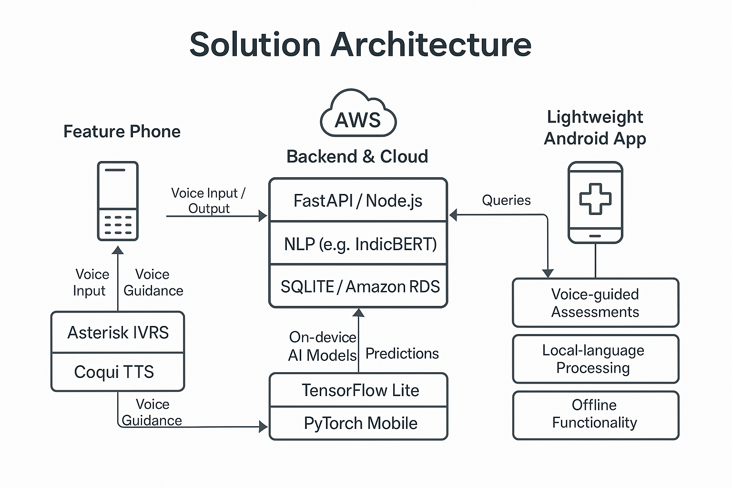
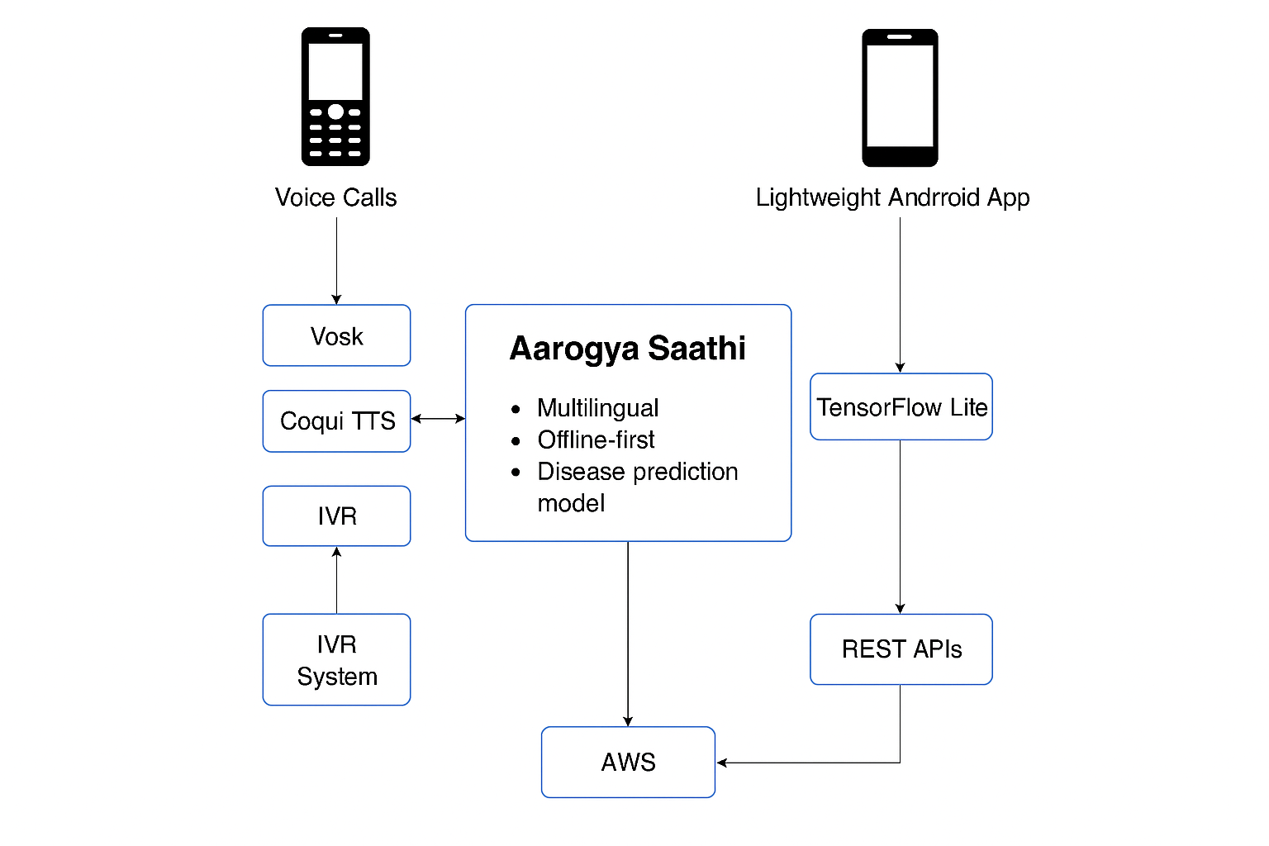
Provide a high-level architecture diagram or a use-case diagram of your proposed solution

Slide 12
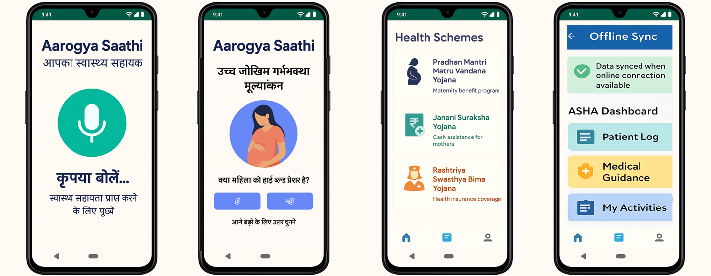
Please share the wireframes/Mock diagrams of the proposed solution (optional)

Slide 13
What datasets will your solution use? Are they publicly available, synthetic, or user-generated?
Yes , Most of them are publicly available.
HMIS (Health Management Information System)
Public maternal health data from MoHFW India
hmis.nhp.gov.in
RCH Portal Data
Reproductive & Child Health statistics
rch.nhm.gov.in
AI4Bharat Datasets
Multilingual speech/text for NLP in Indian languages
ai4bharat.iitm.ac.in
Indic NLP / iNLTK
Indian language corpus for voice/text models
GitHub - Indic NLP
Synthetic Data
Simulated user conversations for model training
User-Generated Data
Real app/IVRS inputs (anonymized, with consent)

Slide 14
Does your solution require cloud-based computation, or can it work with on-device processing? If cloud-based, how do you plan to address connectivity challenges and cost constraints?
Yes, our solution follows a hybrid architecture — it supports both on-device processing and cloud-based computation, depending on the use case and device capabilities.
On-Device Processing
For basic diagnosis, symptom checks, and pregnancy risk assessment, we use lightweight AI models (e.g., TensorFlow Lite, TinyBERT) that run directly on low-end Android smartphones without requiring internet.
This ensures offline functionality, which is crucial for rural areas with poor or no connectivity.
The app uses local storage (Room DB) and WorkManager for delayed data synchronization when connectivity is restored.
Cloud-Based Processing
Feature phone users connect via IVR, where speech processing (Vosk/DeepSpeech) and NLP tasks are handled in the cloud.
Backend logic, language model handling, analytics, and voice synthesis are hosted on AWS services such as EC2, Lambda, RDS, and S3.

Slide 15
Addressing Connectivity and Cost Constraints
The solution uses smart caching and an offline-first design to reduce dependence on real-time connectivity.
Batch data synchronization is performed only when the device regains connectivity, minimizing bandwidth usage.
Cost efficiency is achieved by leveraging serverless AWS Lambda functions, auto-scaling EC2 instances, and open-source AI tools, eliminating the need for expensive third-party APIs.
This balanced approach ensures the solution remains both accessible and cost-effective, regardless of the user's device or infrastructure limitations.
Feasibility:
Aarogya Saathi is technically and practically feasible. It uses lightweight open-source AI tools that run offline on basic phones and smartphones. IVR support ensures reach without internet, while AWS cloud ensures scalability. It aligns with existing ASHA programs for easy deployment in rural areas.

Slide 16
